Slide 1


Buffet Decoration Ordering System
Students:
Abrar Fauzi
Razi Dallasheh
Supervisor:
Zeev Barzily

Slide 2
Concise Description
This system aims to simplify the decoration planning process for event organizers by providing a user-friendly platform where users can browse various decoration options, customize their selections, and efficiently place orders.

Slide 3
The Problem
Customer Struggle with Visualization
Complex and Time-Consuming Process
Challenges in Meeting Expectations

Slide 4
Motivation
Our Goal is to create a system that makes the process of ordering a buffet decoration easy and simple.
The primary goal of the system is to provide users with an intuitive and efficient way to personalize their buffet setups according to their preferences, event themes, and budget.
Simplify the Ordering Process:The system allows users to browse a wide range of decoration options, customize their choices, and place orders seamlessly.

Slide 5
Introduction
Our web Buffet Decoration platform offers user friendly interface enabling effortless ordering and customize buffet decoration.
The platform provides a visualization tool that allows users to visualize their decoration.

Slide 6
Main Requirements
01
02
03
Visualization Tool
Customer Profiles
Responsive Design

Slide 7
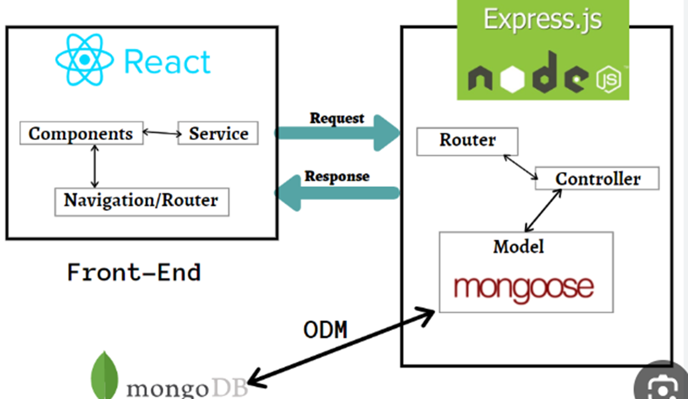
Software Architecture

Slide 8




Technologies And Specialized Software Tools
Vite
React
Security
Visual Code

Slide 9
Development Challenges
The main challenge for us was the deployment process on netlify and render, we encountered so many bugs and errors that if we ran on a local host we wouldn’t encounter them.
We had a difficult time choosing the right MUI-Material in the frontend code of React, because there is simply so many of them to choose and we have to choose the most suitable ones for us.

Slide 10
Development Challenges
The fact that we were beginners at the start of development, made it so difficult for us because we were used to making a simple or static websites with one or two pages, and without a database to back up info.
We took courses in Web Development in order to make a strong and compelling website , which in return it could benefit us for job opportunities.

Slide 11
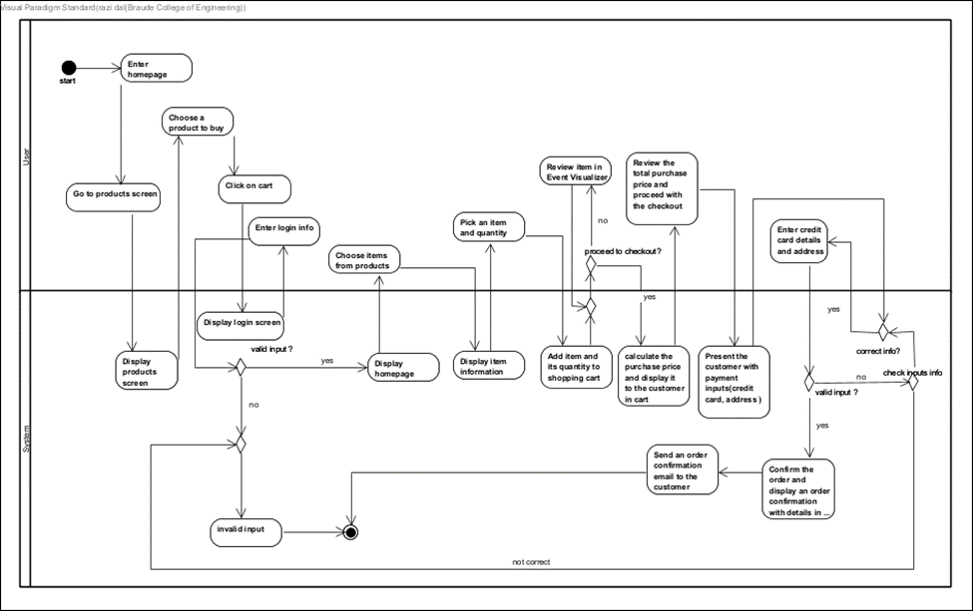
Activity Diagram

Slide 12

Testing
•We documented each action in a table and then verified their functionality on the system.
•The results of our tests were recorded in the table, allowing us to ensure that our system is working correctly, and users can perform their desired actions without any problems.

Slide 13


How we Monitor Our Project Performance
Performance Optimization
User Satisfaction
Reviews
Response Time

Slide 14
challenges
Choosing the Right Database
Handling Data Validation
Optimizing Performance
User Authentication Complexity
Managing State and Session Persistence

Slide 15

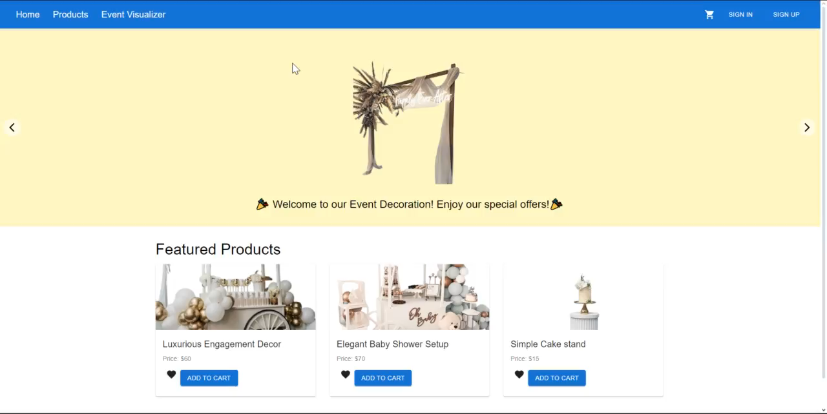
Video Of The System
https://drive.google.com/file/d/1L63vvuln2eiac2EU4VeWcfrPkNmbwJlX/view

Slide 16
Thanks!

